Slide 1
Perkins Liquidation – Best Practices
SWASFAA Training & Continuing Education Committee
April 27, 2021
Notes:
SWASFAA Friends,
Welcome to SWASFAA’s Training and Continuing Education webinar series. Our third webinar of the series, “A Smorgasbord of Topics for Financial Aid Professionals”, will focus on Perkins liquidation.
I will provide the presentation and documentation to all attendees after the presentation and post on the SWASFAA website.
Now, I would like to introduce you to our committee – NEXT SLIDE

Slide 2
Training & Continuing Education Committee
Chair: Shannon Crossland, Texas Tech University
Arkansas Representative: TBD
Louisiana Representative: Ivory Williams, Southern University Shreveport Louisiana
New Mexico Representative: TBD
Oklahoma Representative: Andrew Hammontree, Francis Tuttle Technology Center
Texas Representative: James Smith, Lone Star College
Notes:
Introduce myself –
Introduce Andrew – have him tell a little about himself
Introduce James – have him tell a little about himself
Introduce Ivory – have him tell a little about himself
Call for volunteers –
As you can see, our committee needs representatives from Arkansas and New Mexico. If you are interested in serving on our committee, please let me know.

Slide 3
Perkins Liquidation Best Practices
Program History
Perkins Liquidation
Steps to Liquidate
Lessons Learned/Best Practices
Resources
Contact

Slide 4
Program History
Provide loans to students with exception need
National Defense Student Loan (NDSL) Program
Perkins Loan Program
Administration of Perkins Loans
Notes:
NDSL established in 1958
Changed to Perkins Loan Program in 1986
Under federal law, the authority for schools to make new Perkins Loans ended on Sept. 30, 2017, and final disbursements were permitted through June 30, 2018. As a result, students can no longer receive Perkins Loans. A borrower who received a Perkins Loan can learn more about managing the repayment of the loan by contacting either the school that made the loan or the school’s loan servicer.
Why?
Dwindling loan pool
Burdensome administrative requirements
Lack of funding

Slide 5
Perkins Liquidation
Prescribed process for ending participation in the program
Assignment and Liquidation Guide
Notes:
Link to assignment and liquidation guide in the references section
Why would a school liquidate? Voluntary, eligibility to participate terminated, school closing, etc.

Slide 6
Perkins Liquidation - Steps
Intent to Liquidate***
Notify Borrowers
Assign Loans
Purchase Loans
Update NSLDS
Closeout Audit
Remit Federal Share
Complete Final FISAP Data
Notes:
See best practices and then and now prior to filing intent!!!!
Intent is done electronically in COD on the e-campus based system
Notify servicer
Notify borrowers loans are being assigned to ED – at least 30 days prior to assignment process. Example on page 7 or we can share ours
Assign loans within 45 days*** took 15 months!
Switch to next slide for requirements and then back
Request a recon report from NSLDS
Purchase loans
4 loans ($5,684.00)
Missing MPN
Calculation
Update NSLDS - See separate Slide
Closeout Audit – Independent Auditor – three-six months
Single Audit Act – can choose independents or combine with school’s audit
Not under single audit act must have independent audit
Trying to tie back to numbers decades ago
Remit Federal Share – G5 – auto calculated –
FISAP
Receive Official Letter – happened in less than 24 hours after submitting the audit report.

Slide 7
Required for All Loans
Assignment Forms
Assignment Manifest
Original or Certified True Copy of MPNs
Repayment History Records
Special Cases
Disbursement Records
Judgment Information
Death Certificates
Registered Mail
Notes:
Missing MPN – must provide a statement certifying copy – example pg. 11 or we can send you ours
Multiple loans on one note – rules on page 11 of guide
Repayment records – financial profile of the account
Disbursement records – if applicable –
Judgment (waited over five months for a response) work with your general counsel.
ED does not accept assignment of loans for which the institution has obtained a judgment unless the original or certified copy of judgment is transferred. **** some states require the school to notify the court – worked with our general counsel. We can provide statement.
Death certificates – contact county clerk for copies – consider fees – time. Your office is responsible for fees.
Credit Balances
> $50 Refund
< $50 Keep

Slide 8
PLAS
PLAS – Perkins Loan Assignment System
Electronic submission
Notes:
Cathy – discuss inputting – tedious process
Screen shots – next slides

Slide 9
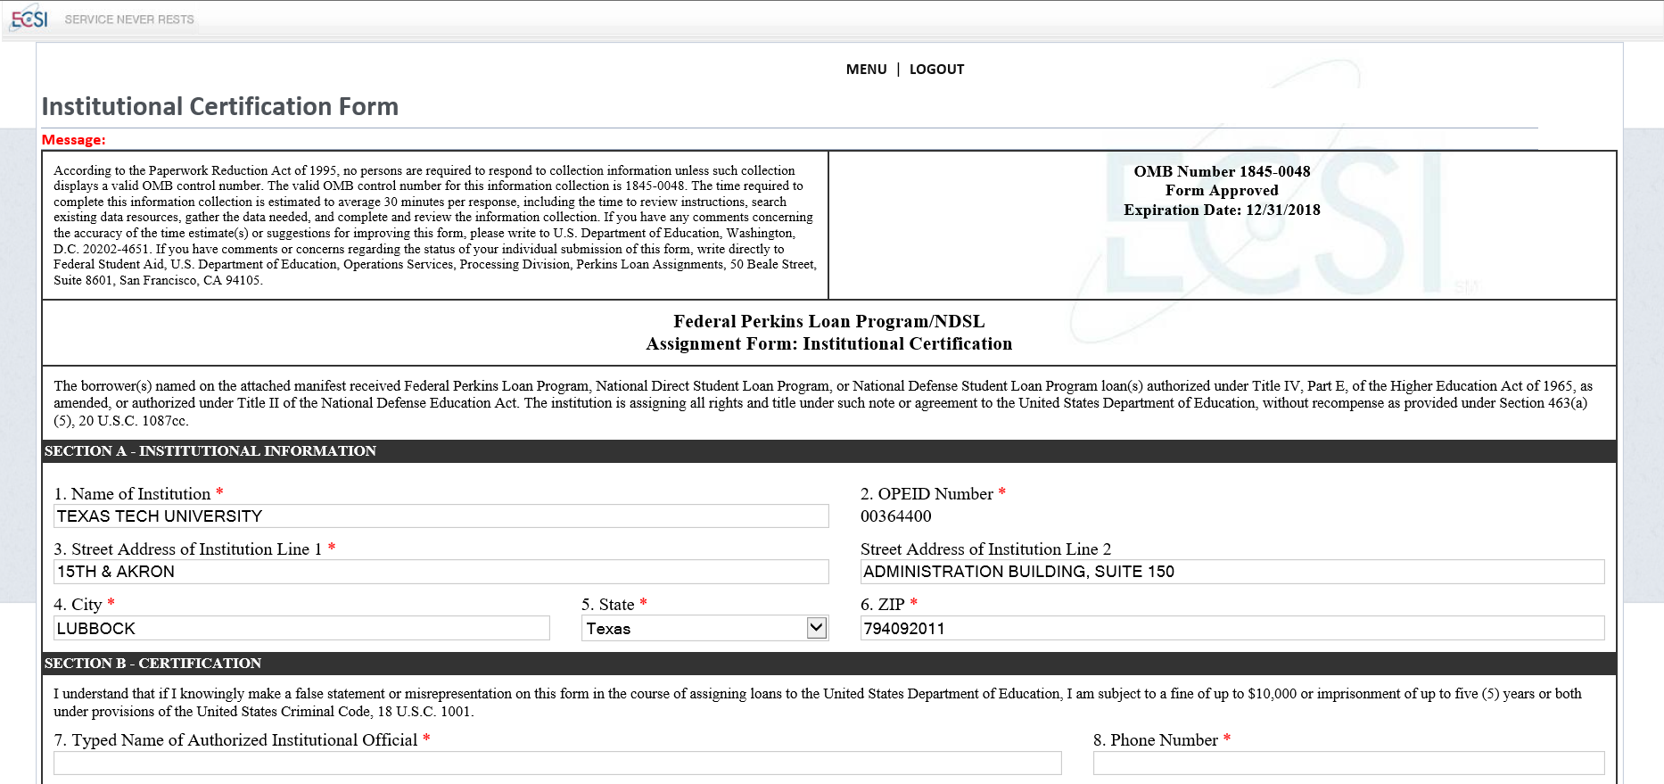
PLAS

Slide 10
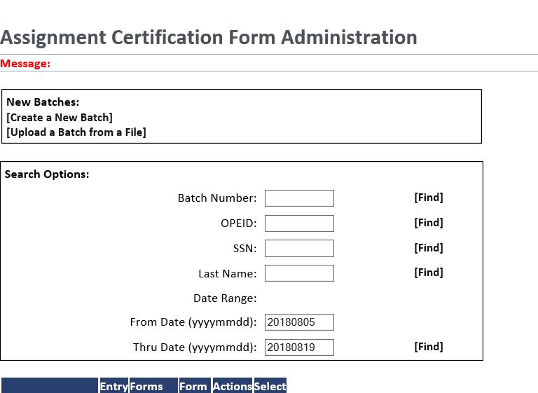
PLAS

Slide 11
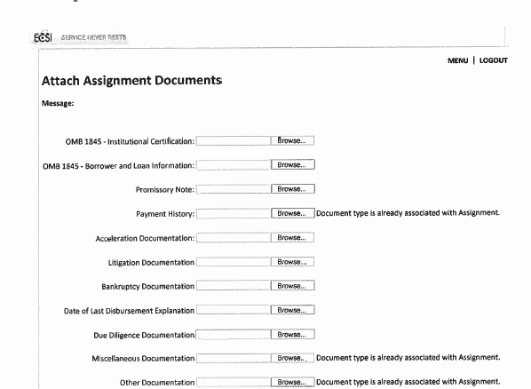
PLAS

Slide 12
NSLDS
Perkins liquidation requires that there be zero open loans in NSLDS
Reconciliation report from NSLDS
Loans Accepted for Assignment
After purchase – report purchased loans
Notes:
RECON report from NSLDS – we used this as our working document to inventory, etc to ensure all loans are account for. Reconcile with total amount of loans and number of borrowers with the school.
Upon acceptance – update NSLDS – spreadsheet submittal – use
NSLDS Perkins Spreadsheet Submittal Instruction Guide Notes
Spreadsheet Submittal
Page 29
Action Code – set to space
Date of Loan Status – date submission on manifest
Code for Loan Status – AE (Assigned)
Indicator for Grant Overpayment – blank out
NSLDS
If loan already assigned to ED – do not need to submit it.
If loan in default and assigned to ED – do not need to report.

Slide 13
Then & Now
Schools can assign defaulted or non-defaulted Perkins loans at any time rather than liquidating
Gather all information prior to intent
Ensure staff have PLAS access prior to intent
Notes:
Had I been given the choice – I would have chosen to liquidate
Institutional share – creating an “emergency fund”

Slide 14
Best Practices
Consider the financial implications of liquidation
Prior to notifying ED of intent to liquidate
Inventory loans – original MPNs, repayment history, disbursement records, judgment records, death certificates
Notes:
Financial implications
Assess the Perkins portfolio by classifying loans into categories of performing and non-performing
Consider the actual cost to the university (institutional cost plus additional close-out costs)
Consider vendor contracts if you have a loan servicer agreement - Early-out clause
Once we entered in COD – the minute hit submit received notice of federal share due!

Slide 15
Resources
Assignment & Liquidation Guide
https://ifap.ed.gov/cbpmaterials/attachments/PerkinsAssignmentandLiquidationGuide.pdf
NSLDS Perkins Spreadsheet Submittal Instruction Guide
https://fsadownload.ed.gov/Repository/NSLDSPerkinsJuly2016/PerkinsSpreadsheetSubmittalInstructionGuide.pdf

