Slide 1
Policies & Procedures Pathway – Overview of tools Utilizing Windows File explorer
SWASFAA Training & Continuing Education Committee
Notes:
Welcome Friends. We are so excited to have you join us.
On behalf of SWASFAA, if there is anything we can during your remote transition and possible remote back to campus, please don’t hesitate to reach out and let us know.
Let’s start out third installment of Overview of Tools as part of the P&P Pathway. We have talked about the NASFAA Compliance Engine, Creating an Internal Sharepoint and Now we will talk about utilizing windows file explorer.

Slide 2
Overview of Tools – Utilizing Windows File Explorer
Notes:
Same process/thinking as the Sharepoint presentation from our April webinar
SHARED DRIVE
Staff can access from offsite; counter, etc.

Slide 3
Overview of Tools – Utilizing Windows File Explorer
Notes:
Within the P&P Folder for each component, folders were created. Note – The two base folders in every P&P folder are Archive and P&P Documentatoin and Word Documents.

Slide 4
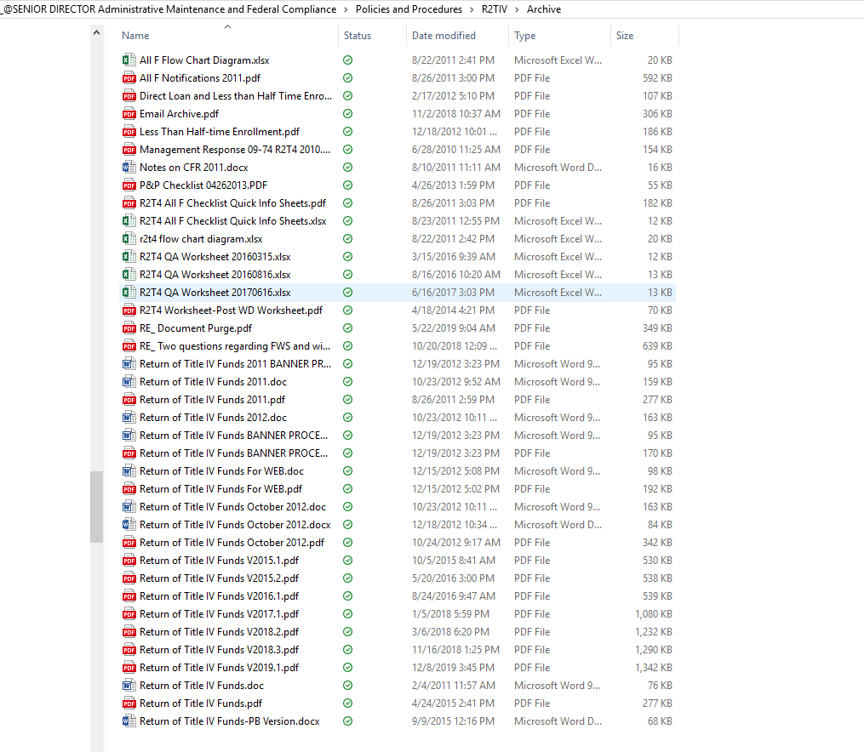
Notes:
Let’s look at our Archive Folder – as you can see – with R2TIV – several
Show Archived polices, etc.

Slide 5
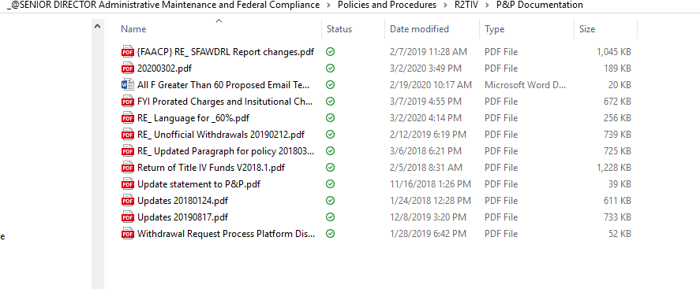
Notes:
Let’s look at our P&P Documentation folder – when updates are made to a policy during our annual review:
Policy and procedure is sent to appropriate staff for review and then “turned in” Signed as reviewed – documentation!!

Slide 6
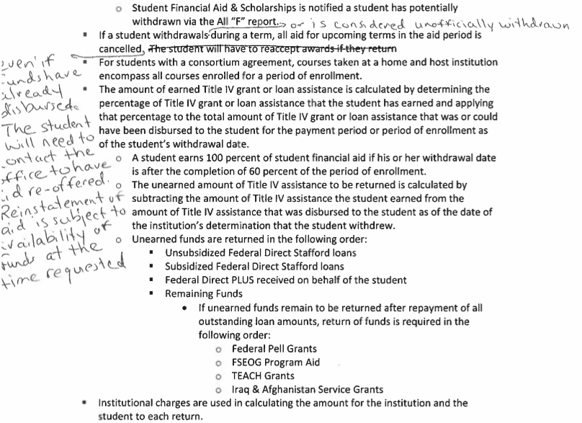
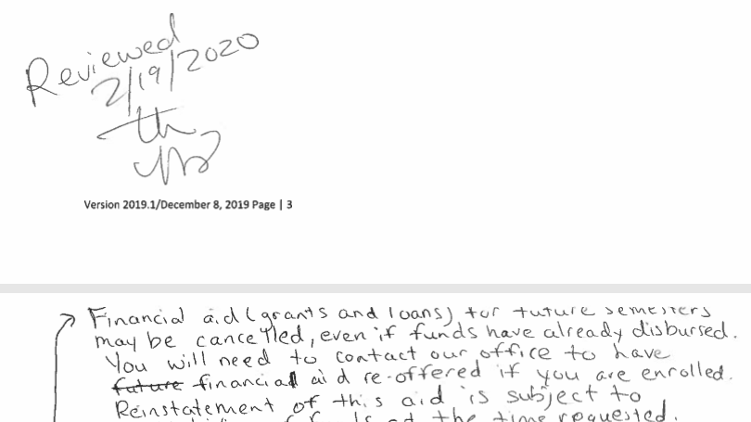
Notes:
Example of a policy review.

Slide 7
Q&A TIME
What is on your mind SWASFAA?
Notes:
Since our presentation was very short – I would like to open the webinar up to Q&A Time or Comment Time.
What is on your mind SWASFAA??

Slide 8
SWASFAA NEEDS YOU!
Volunteer - https://www.swasfaa.org/Volunteer
Committee Members
Chair: Shannon Crossland, Texas Tech University
Arkansas Representative: TBD
Louisiana Representative: Antoinette D Brown, University of Louisiana at Lafayette
New Mexico Representative: TBD
Oklahoma Representative: Audra Main, Moore Norman Technology Center
Texas Representative: James Smith, Lone Star College
Notes:
Currently our committee needs representatives from Arkansas and New Mexico. Please let us know if you are interested.
Welcome our newest committee member – Antoinette Brown from the University of Louisiana at Lafayette
Thank you to committee members
Next Webinar will be in June – June 9th to discuss enhancement and oversight – action plans, prevention, quality checks, risk assessments and control activities.
Final Thought
Do we change how we do processes or do we change the policy and procedure?

