Slide 1
SWASFAA Training & Education Committee Policy & Procedure Pathway Overview of Tools: Creating an Internal Sharepoint
Notes:
WELCOME FRIENDS
Cataloging & Monitoring Internal Compliance Efforts Utilizing SharePoint
Background/History/Need
Logging
Central place – front counter/traveling/
Documentation Source
Grant view access for auditors

Slide 2
Overview of Tools – Creating an Internal SharePoint
Notes:
Thought behind this approach:
Do we change how we do processes or do we change the policy and procedure?
Organizing & monitoring compliance utilizing sharepoint –
Build this in-house
Staff can sign-in remotely
Overview of SharePoint
(quick overview then we will do a real-time demonstration of the components – put screen shots in slides for you to have a visual or guide)
HAVE LOG IN READY to SHOW THEM!!!
https://sharepoint13.itts.ttu.edu/em/Compliance/default.aspx
Three Main Components
1. Lists
2. Discussions
Libraries
LISTS
Audit/Compliance Internal Disclosure Report
Explain layout
Complete this form to report any compliance issues.
Select Add New Item
Complete the form
Internal # (leave blank) (internal system – I do ours based on terms)
Attach any documentation
Date – auto
Financial Aid Area
Staff Involved (list all staff involved)
Be as detailed as possible
Explain how the issue was corrected
Corrective Action Plan moving forward (this plan will be monitored to ensure internal control.)
Select Save
Shannon completes the log information.
Email Distribution
Compliance Events
Work in progress (starting with 2016, will assess each month)
Compliance Policy and Procedure
Explain Layout
Select Add New Item
Name of P&P that needs updates or edits.
Attach all documentation
Effective date of policy
Why?
Select save.
Email distribution
Consumer Information Assessment (NEWEST ADDITION to the Site)
Explain Layout
Next steps – workflow for notification across campus
DISCUSSIONS
Discussion Boards serve as a means of documentation for P&P updates. Discussion boards are not to be used to discuss compliance issues. Use the disclosure or P&P report.
LIBRARIES
All policies and procedures are located in these libraries.
For the SharePoint to be successful, all policies and procedures will only be updated through the site in an effort to assess the effectiveness and allow for an archive of all updates as well as a date and timestamp.

Slide 3
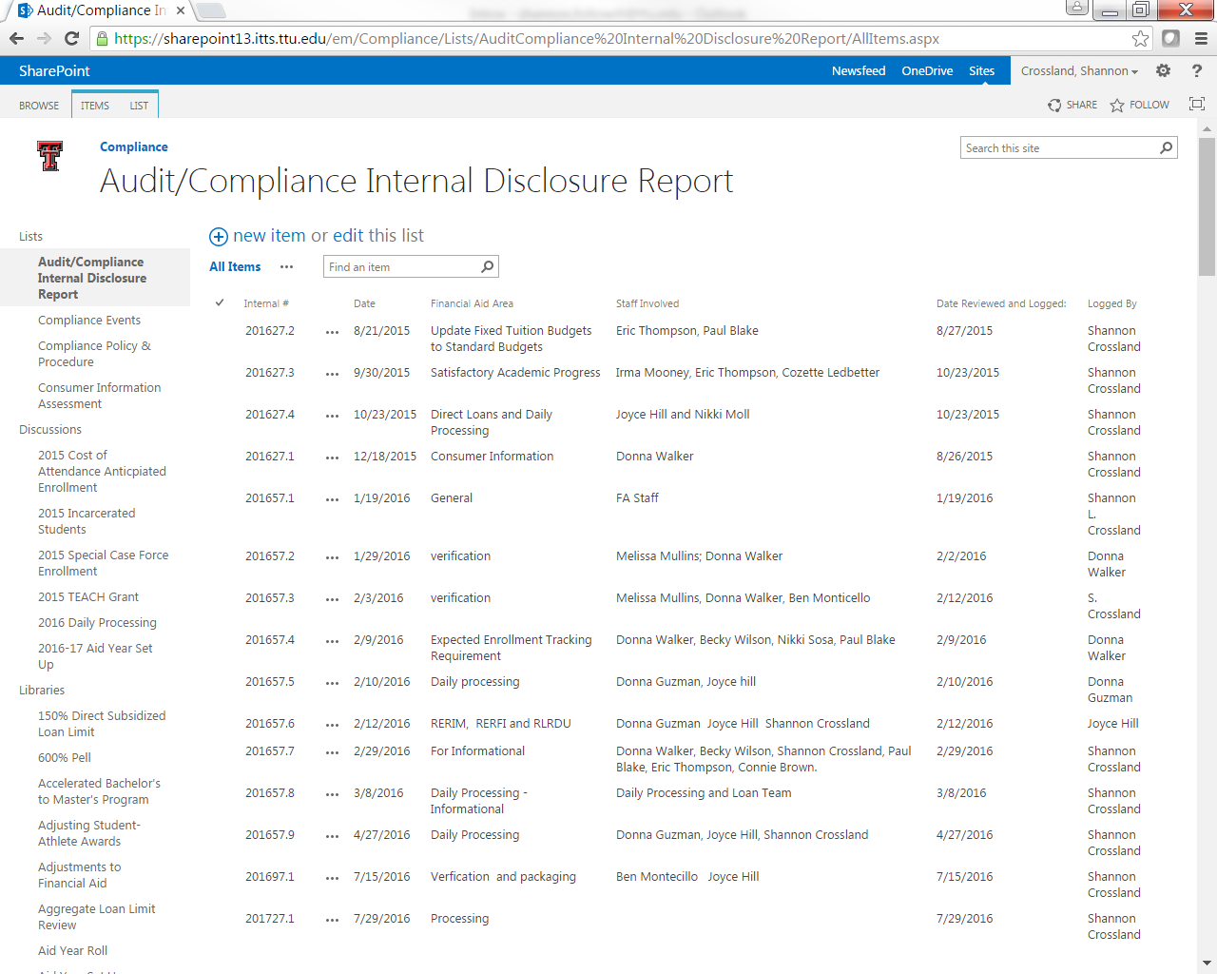
Notes:
Three Main Components
1. Lists
2. Discussions
3. Libraries

Slide 4
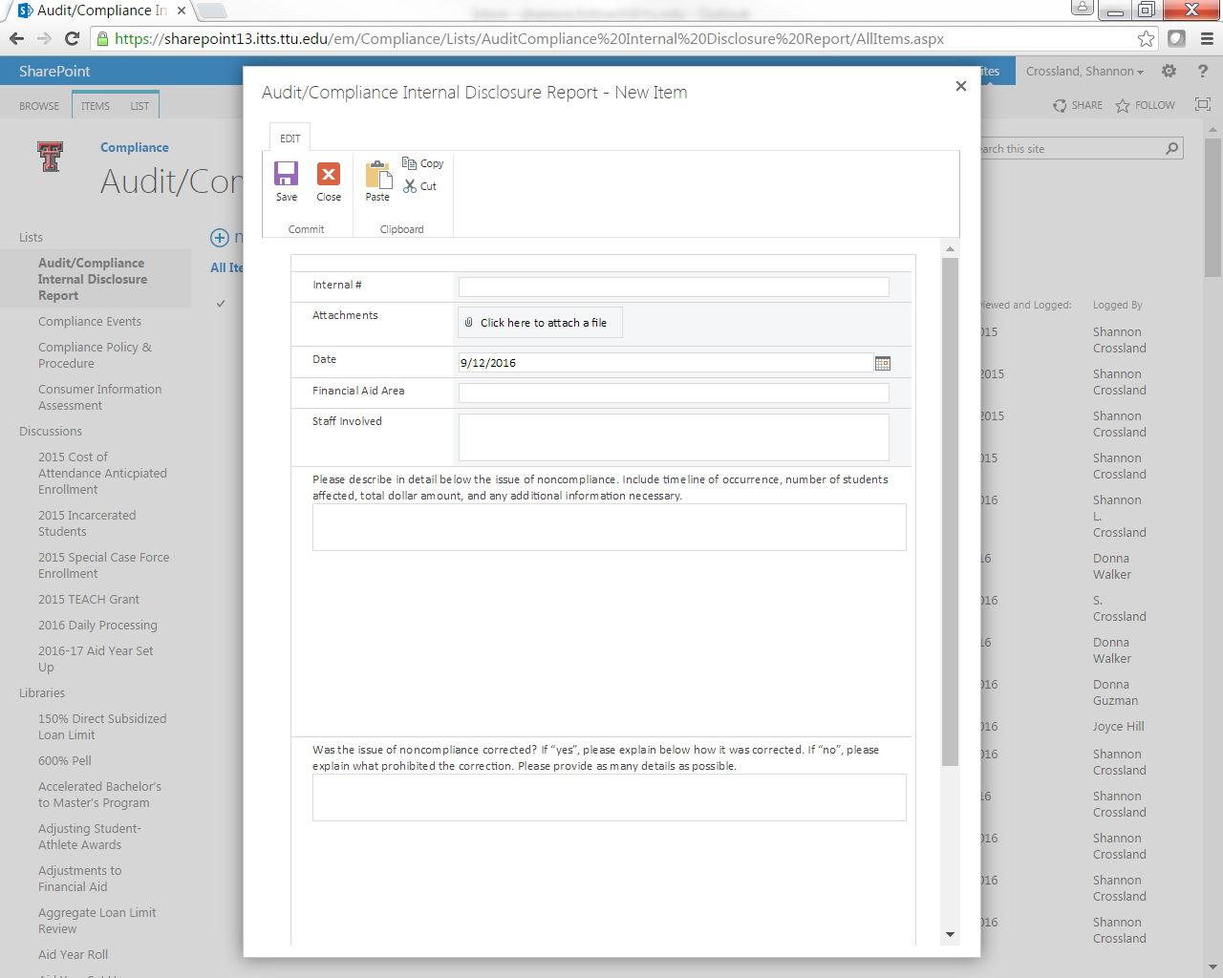
Notes:
Audit/Compliance Internal Disclosure Report
Complete this form to report any compliance issues.
Select Add New Item
Complete the form
Internal # (leave blank)
Attach any documentation
Date – auto
Financial Aid Area
Staff Involved (list all staff involved)
Be as detailed as possible
Explain how the issue was corrected
Corrective Action Plan moving forward (this plan will be monitored to ensure internal control.)
Select Save
Shannon completes the log information.
Compliance Events
Work in progress – Training Archive

Slide 5
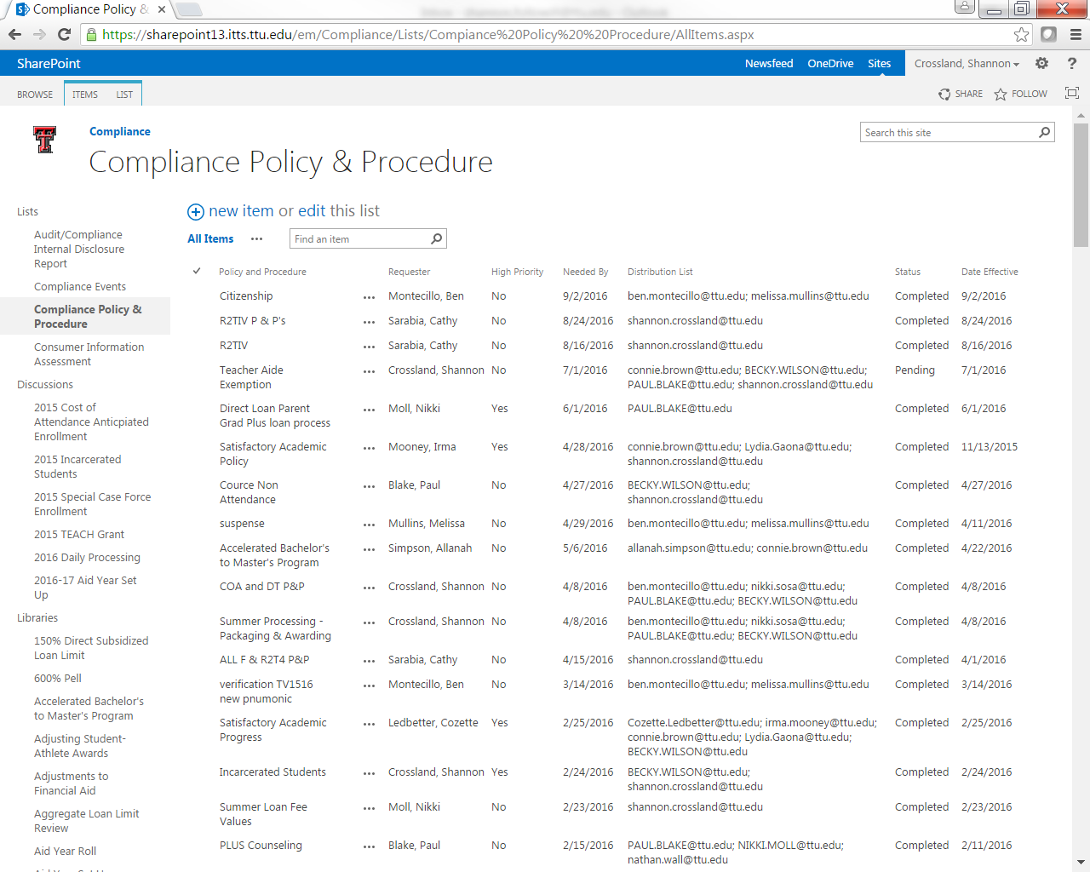
Notes:
Compliance Policy and Procedure
Select Add New Item
Name of P&P that needs updates or edits.
Attach all documentation
Effective date of policy
Why?
Select save.

Slide 6
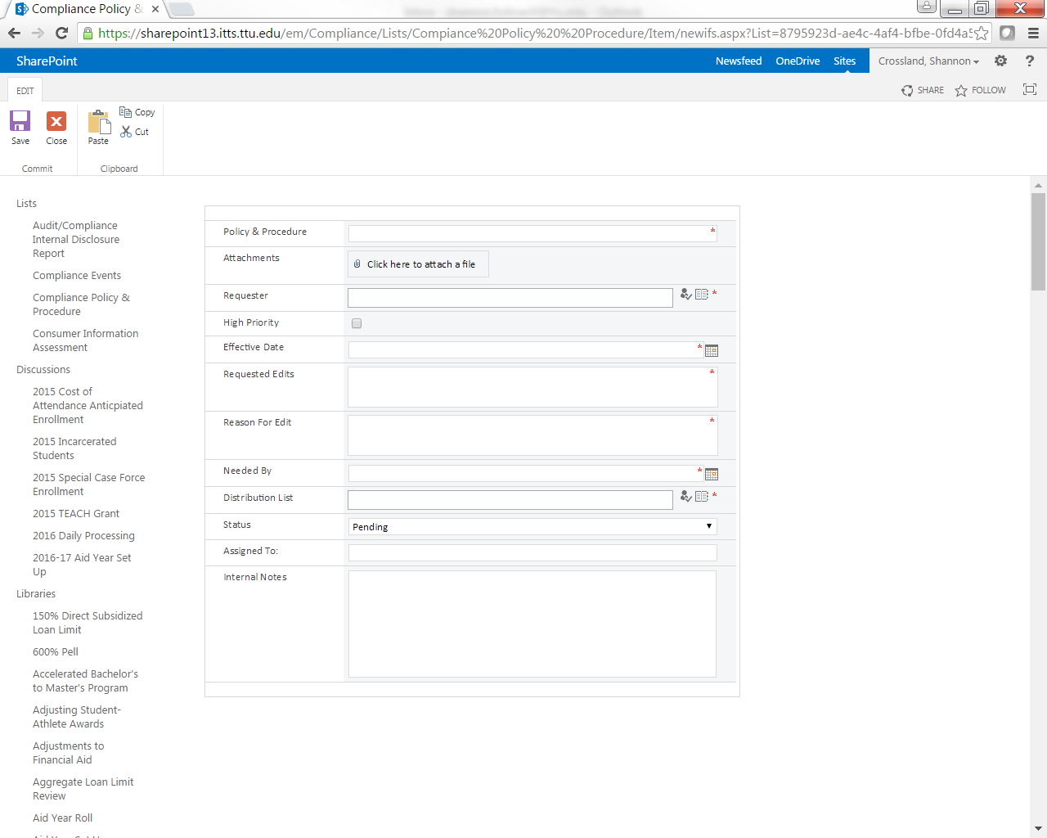

Slide 7
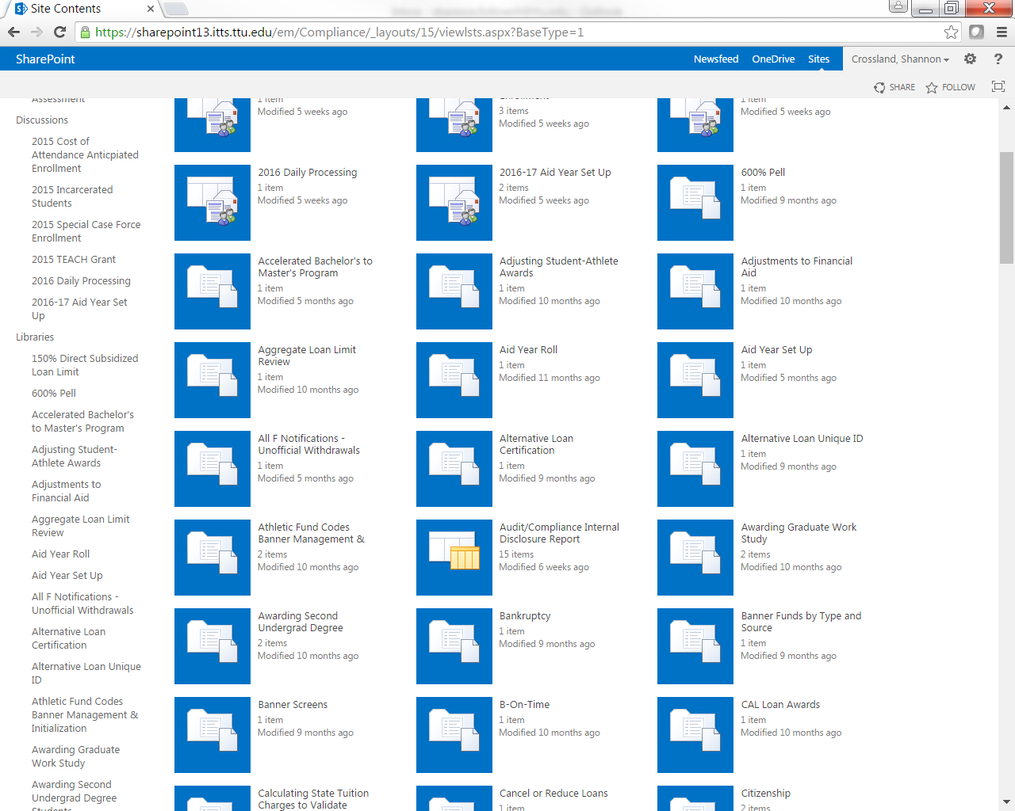
Notes:
DISCUSSIONS
Discussion Boards serve as a means of documentation for P&P updates. Discussion boards are not to be used to discuss compliance issues. Use the disclosure or P&P report.
LIBRARIES
All policies and procedures are located in these libraries.

Slide 8
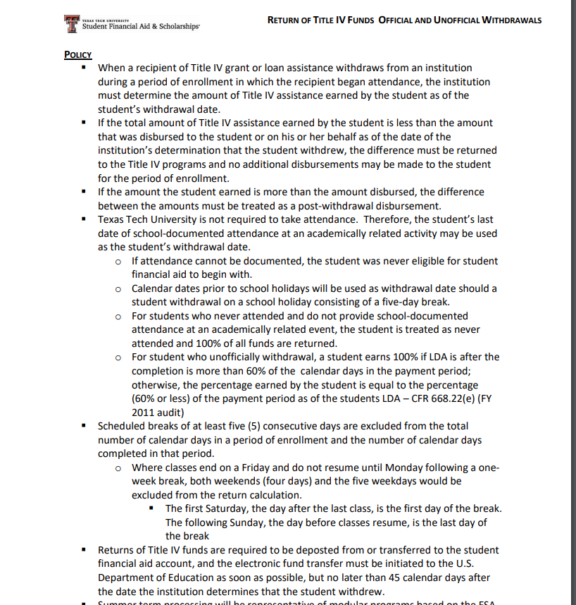
Overview of Tools – Creating an Internal SharePoint

Slide 9
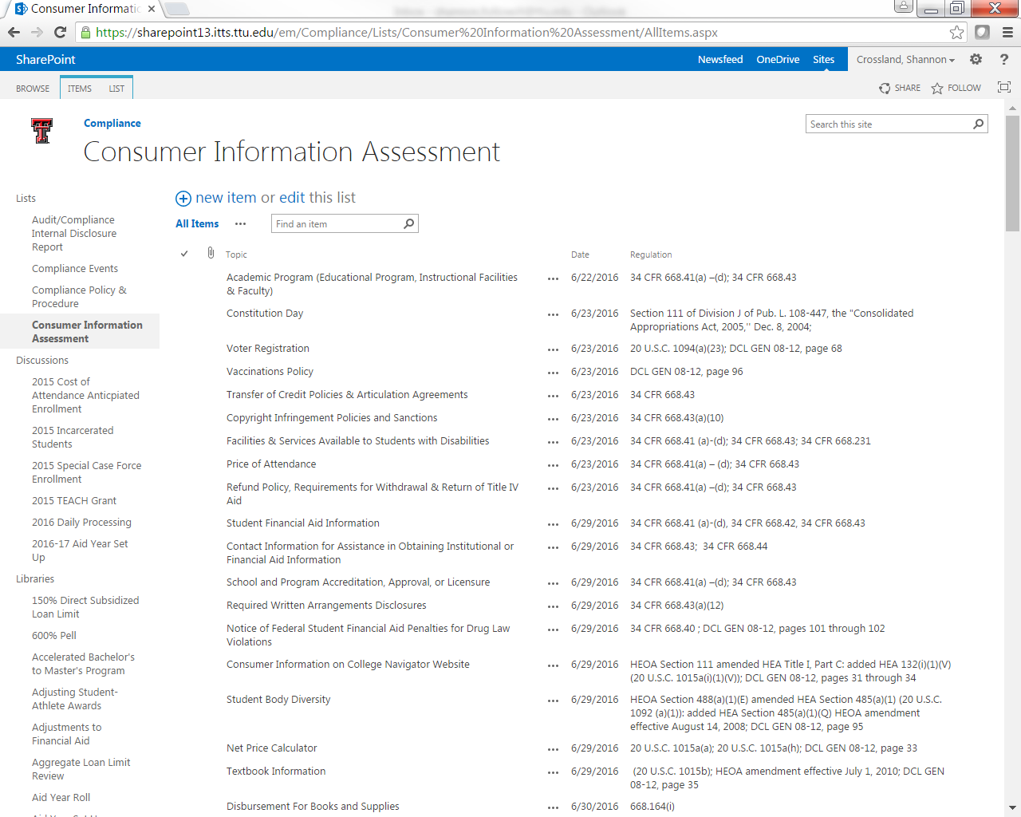
Notes:
Used the sharepoint to develop our consumer information assessment library.

Slide 10
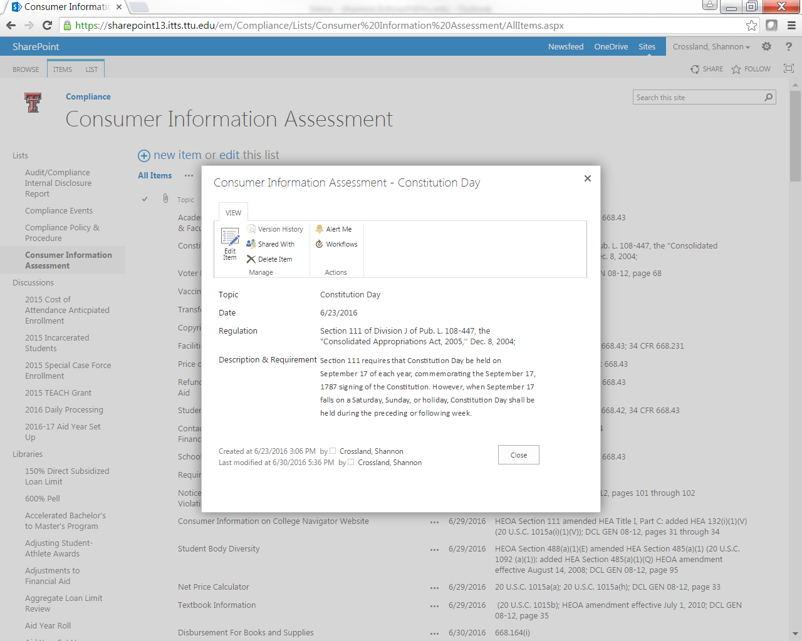
Notes:
For the SharePoint to be successful, all policies and procedures will only be updated through the site in an effort to assess the effectiveness and allow for an archive of all updates as well as a date and timestamp.
Other Applications/Moving Forward/Best Practices
NASFAA Ask Regs
Student Aid Index

Slide 11
SWASFAA NEEDS YOU!
Volunteer - https://www.swasfaa.org/Volunteer
Committee Members
Chair: Shannon Crossland, Texas Tech University
Arkansas Representative: TBD
Louisiana Representative: Antoinette D Brown, University of Louisiana at Lafayette
New Mexico Representative: TBD
Oklahoma Representative: Audra Main, Moore Norman Technology Center
Texas Representative: James Smith, Lone Star College
Notes:
Currently our committee needs representatives from Arkansas and New Mexico. Please let us know if you are interested.
Welcome our newest committee member – Antoinette Brown from the University of Louisiana at Lafayette
Next Webinar will be in May to discuss the final section on overview of tools by utilizing an internal sharepoint.
Final Thought
Do we change how we do processes or do we change the policy and procedure?

