Slide 1
SWASFAA Policies & Procedures Pathway Enhancement & Oversight
SWASFAA Training & Continuing Education Committee
June 9, 2020
Notes:
Welcome friend to our June webinar.
I hope all of you are doing well. Please let SWASFAA know if there is anything we can assist with!
Mendy – President say a few words.

Slide 2
Enhancement and Oversight
Position Descriptions
Control Activities
Action Plan
Prevention
Quality checks/Quality assurance
Risk Assessments
Notes:
Let’s get started and visit about enhancement and oversight as part of our policies and procedures pathway!
Agenda

Slide 3
Enhancement and Oversight
Proper documentation for a student’s file
Staff follow procedures established within the office
Incorporate internal reviews to ensure processes are documented
Incorporate risk assessments
Notes:
Examples include

Slide 4
Control Activities
Control Activities are the policies, procedures and practices management establishes to achieve objectives and respond to risks.

Slide 5
Position Descriptions
Monitor regulatory and administrative requirements for Title IV federal student aid programs.
Create, coordinate and publish internally a policies and procedures manual for each area and specific function within the Office of Student Financial Aid.
Monitor policies and procedures to ensure compliance with respect to Title IV federal student aid for each area/specific function within the Office of Student Financial Aid.
Ensure adherence by staff to the code of federal regulations with respect to Title IV federal student aid as compiled by the Department of Education.
Provide training on updates and issues with respect to the financial aid.
Provide learning resources for employees with respect to the financial aid.
Provide regulation and operational guidance with respect to financial aid.
Research and brief Leadership Team of recently adopted regulations with respect to Title IV aid.
Assist in federal audits for financial aid – gathering information, providing requested documents and following-up post audit requests.
Notes:
Compliance position descriptions (examples above) have responsibility for enhancement and oversight - not just for FA but for the institution as a whole.
Sometimes enhancement and oversight requires discussions outside of FA – i.e. - Registrar, provost, athletics, admissions, e-learning, etc.

Slide 6
Action Plans
Action plan is designed to help you update your policies and procedures in an organized way
Review your policies and procedures to ensure best practices are being utilized
Who needs to be involved?
Long term vs. short term
Date stamp and archive
Randomly have policies and procedures pulled for review for errors
Notes:
Examples of action plans include the above
SAP/Verification
Document discussions – is everyone around the table?
COVID – short-term
10 P&Ps a month

Slide 7
Prevention
Were procedures followed?
Is all required documentation in the student’s file?
Are all forms signed?
Can you determine what was done and why by the team member?
Notes:
This could save you from audit findings
We are all busy, however a little prevention goes a long way
What to review
Did your team member follow procedures?
Is all required documentation in the student’s file?
Are all forms signed?
Can you determine what was done and why by the team member?
Share EXAMPLES
R2TIV internal review
Cost of Attendance Review
Verification

Slide 8
Quality Checks/ Quality Assurance
Date stamp and archive
Randomly have files pull for review for errors
Notes:
Establish some reports to help you?-Example quality checks
James from Loan Star will next share with you their Quality Assurance Team Training Plan

Slide 9
Quality Checks/ Quality Assurance
Quality Assurance Team Training Plan
Risk Assessment
Intro Audit
Simultaneous Audit
Individual Audit
Notes:
James from Loan Star will review their Quality Assurance Team Training Plan
Quality Assurance Team Training plan
The training process will be broken down into 4 phases: Risk Assessment, Intro Audit, Simultaneous Audit, Individual Audit with coordinated alternating review
Phase 1: Risk Assessment
This will be done in several steps each building on each other resulting in a completed risk assessment.
Expose the team to the wide-ranging number of items in financial aid. They have not been exposed to many of the parts of financial aid and before working on the risk assessment and trying to determine what an items risk and controls would be. This includes having the team read audit reports from prior Lone Star financial aid audits, review IFAP, ED Handbook, COSO model, and other resources. This will result in each team members creating their own lists of what they think would be reviewed.
Have the team review risks types and then create a list of risks to evaluate the financial aid items on. This includes which risks, how to rate them, and how much weight each should have.
Based on these pieces of information a risk assessment will be created. Each item will be reviewed in relation of all the types of risks. During this review process an assessment of each team members knowledge of each item will be addressed based on their answers to how they view the risks and own admissions of their knowledge of the items. For each item that needs any team training due to lack of knowledge will be discussed once the risks are being evaluated. Each team member will be expected to have a moderate understanding of all items on the risk assessment and what it is and how it works.
Once all risk and item trainings have been concluded a review of each item’s controls will be conducted. This will allow for an additional review of each item but also allows for a complete and through risk assessment.
The completed risk assessment will then be used to create a Quality Assurance review plan. The plan will include reviews to be reviewed in a year and how will be the primary reviewer for the item.
Phase 2: Intro Audit
As a team a single item will be reviewed. The team will learn the steps and processes of how to complete an audit (item discovery, data pull and analysis, creation of testing sheet, pulling a sample, reviewing items in sample, compiling results, determining issues and recommendations). Once this audit is complete it will be presented to financial aid executive leadership. This phase is mostly to teach how an audit is conducted to the team.
Phase 3: Simultaneous Audit
Each member of the team will conduct an audit of the same item simultaneously. This will allow for each team member to preform an audit but under constant supervision and then be able to discuss each stage of the audit as a team and see how each member’s choices differ and allow them the opportunity explain why they made the choices they made. This will be wrapped up as a team and a single audit result will be produced and presented to financial aid executive leadership.
Phase 4: Individual Audit with coordinated alternating review
Each member will conduct an audit of a separate item (under significant supervision). These audits will be then reviewed by another team member and they will provide feedback to the member who preformed the audit. This will provide additional experience in having difficult conversations and offering suggestions to coworkers. Each team member will present their completed audit to the financial aid executive leadership.
End of training: Once these steps are complete the team will begin preforming reviews as part of the plan created above.

Slide 10
Risk Assessment
Risk Assessment Examples
Risk Legend
OIG Oversight Report
Use as case studies
Training
https://www2.ed.gov/about/offices/list/oig/rpauditfsa.html
Notes:
Shannon will share risk assessment and James from Lone Star will share his risk assessment and risk legend
Risk Assessment – Use OIG oversight report – read – use as case studies – training –

Slide 11
Risk Assessment
Risk Management Questionnaire
Risk Assessment
Mitigation Activities
Monitoring Activities
Notes:
Shannon – Coordinated through our Systems Office

Slide 12
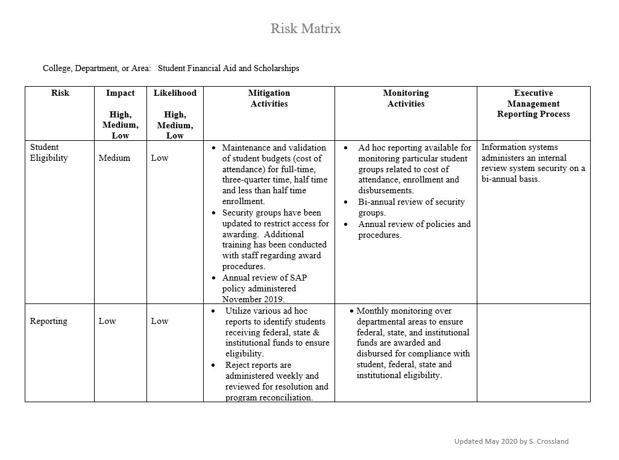
Notes:
Shannon – Coordinated through our Systems Office

Slide 13
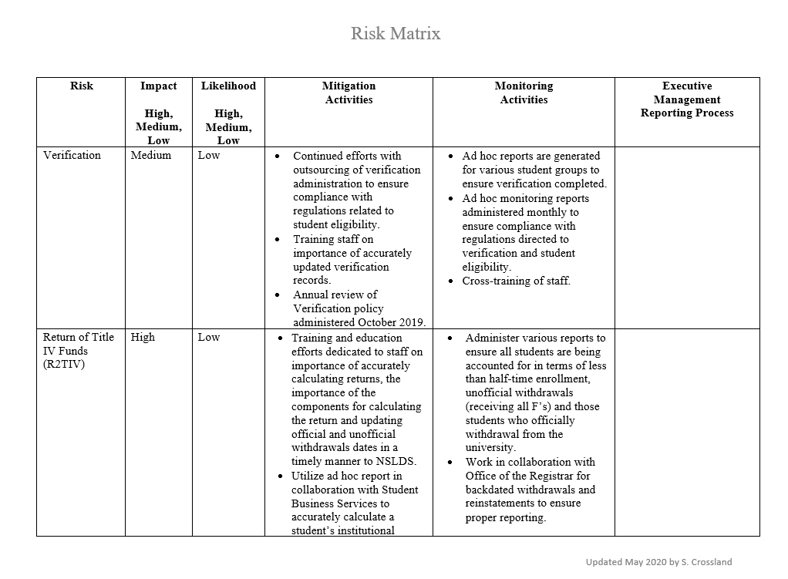
Notes:
Shannon – Coordinated through our Systems Office

Slide 14
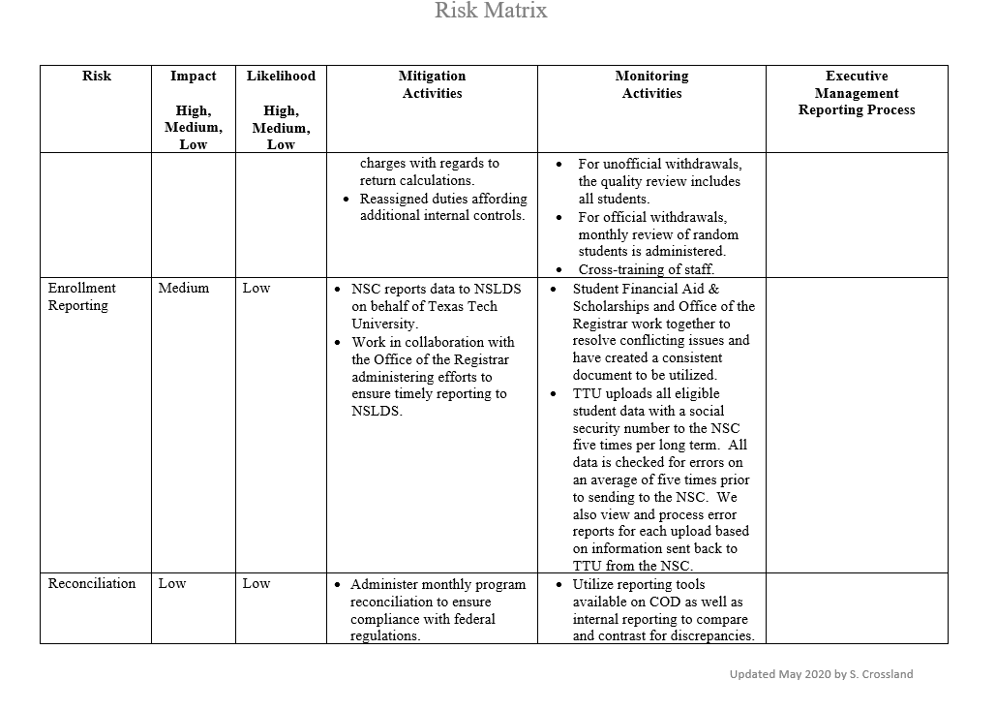
Notes:
Shannon – Coordinated through our Systems Office

Slide 15
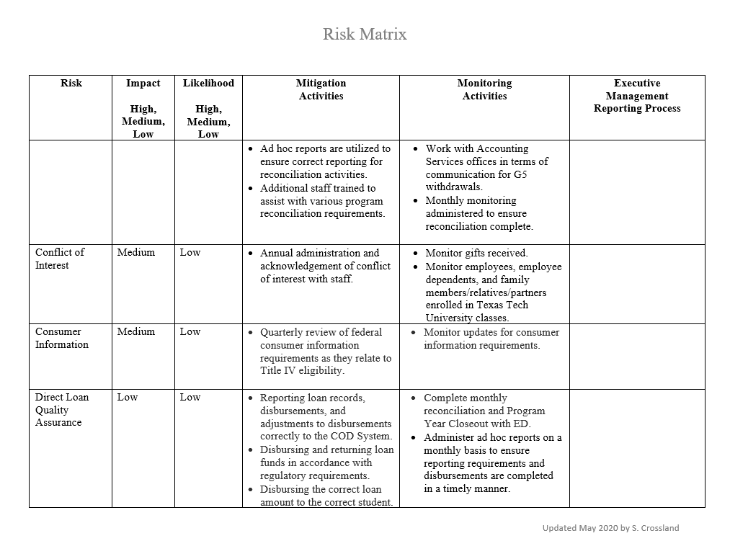
Notes:
Shannon – Coordinated through our Systems Office

Slide 16
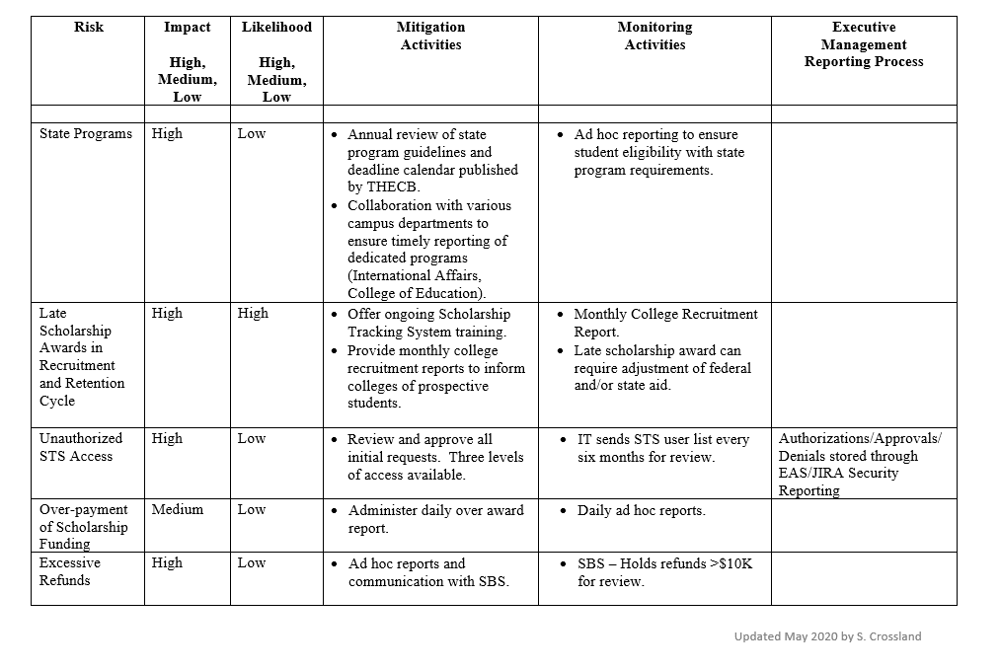
Notes:
Shannon – Coordinated through our Systems Office

Slide 17
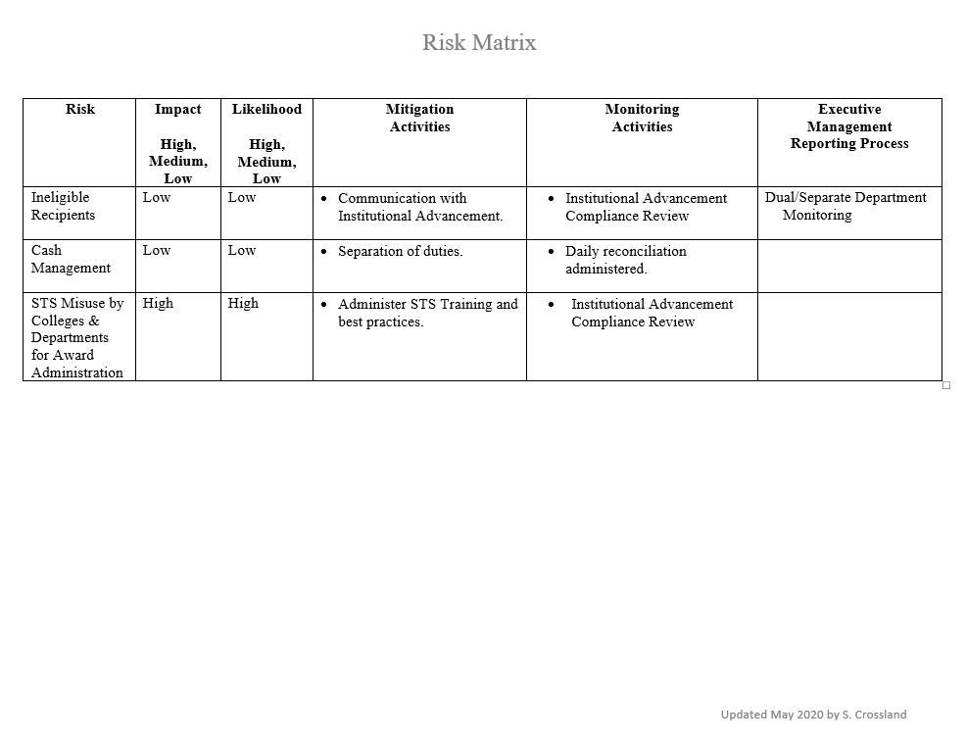
Notes:
Shannon – Coordinated through our Systems Office

Slide 18
Notes:
Shannon – Coordinated through our Systems Office

Slide 19
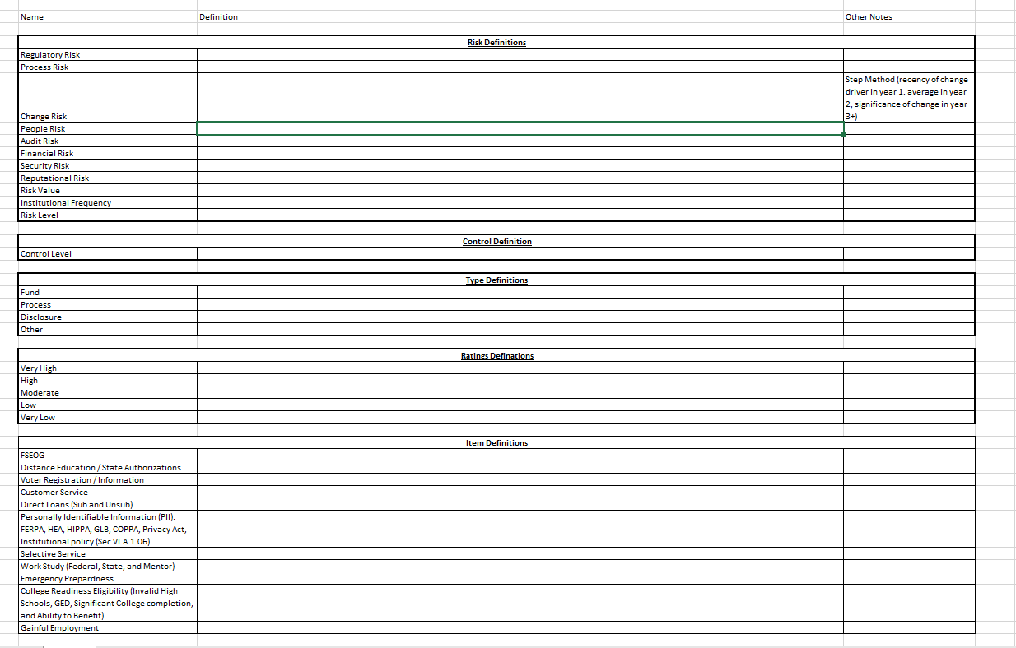
Notes:
Shannon – Coordinated through our Systems Office

Slide 20
Questions?
Discussion
Notes:
Thank you James for sharing your assessment and legend.

Slide 21
Committee Members
Chair: Shannon Crossland, Texas Tech University
Arkansas Representative: TBD
Louisiana Representative: Antoinette D Brown, University of Louisiana at Lafayette
New Mexico Representative: TBD
Oklahoma Representative: Audra Main, Moore Norman Technology Center
Texas Representative: James Smith, Lone Star College
Notes:
Currently our committee needs representatives from Arkansas and New Mexico. Please let us know if you are interested.
Next Webinar will be in July (date to be determined) to discuss engagement and training – tools, cross-training, presentation, staff by in.

