Slide 1
Overview of Tools: NASFAA Compliance Engine
SWASFAA Training & Continuing education committee
Policies & Procedures Pathway webinar
March 30, 2020 10:00 a.m. CST

Slide 2
Included in NASFAA Value Plus Membership –
Standard and Value members can add the P&P Builder to their membership dues renewal invoice for $99/year, per institution
One subscription covers access for all employees at the institution

Slide 3
The online P&P Builder was built to address a need on campus for an easy-to-update, accurate P&P. Aid offices are already doing a lot with few resources. This tool is intended to streamline a cumbersome (but necessary) process.
Completing the first manual will take some time; but once completed, only portions that have new regulatory requirements will require updates in subsequent years
The P&P Builder tells you exactly what regulations are needed - no more guess work!
    Each section of the P&P Builder contains links to the applicable federal regulations institutions must adhere to; this resource is invaluable to schools who are completing or updating their policies and procedures manuals
Centralizes all compliance and policies and procedures information online
Notes:
July 2016 – NASFAA introduced the Compliance Engine, an online tool combining two of NASFAA’s popular PDF-based tools, the Self-Evaluation Guide, and the Policies & Procedures Manual template.
Benefits of moving from PDF to the Web:
Collaborative environment supports inter-departmental sharing
Centralization of compliance and P&P data
Email notification of key content updates
Task and deadline management
Served as Chair - The Policies & Procedures Compliance Engine Implementation Task Force was asked to
Assess whether the tool meets user needs (may impact future development considerations),
Identify adoption/implementation challenges and concerns, and
Help NASFAA develop outreach materials to encourage users to transition to, and maintain their work within the tool.

Slide 4
Managing a P&P manual can be a challenge:
  Keeping up to date with federal, state, and institutional changes is daunting
  Manuals are often in pieces and scattered around the office in various locations and formats
NASFAA’s P&P Builder alleviates many of these problems:
  Provides a central online location for a complete manual
  Provides links and references to regulations, as well as email notifications about the latest regulatory changes

Slide 5
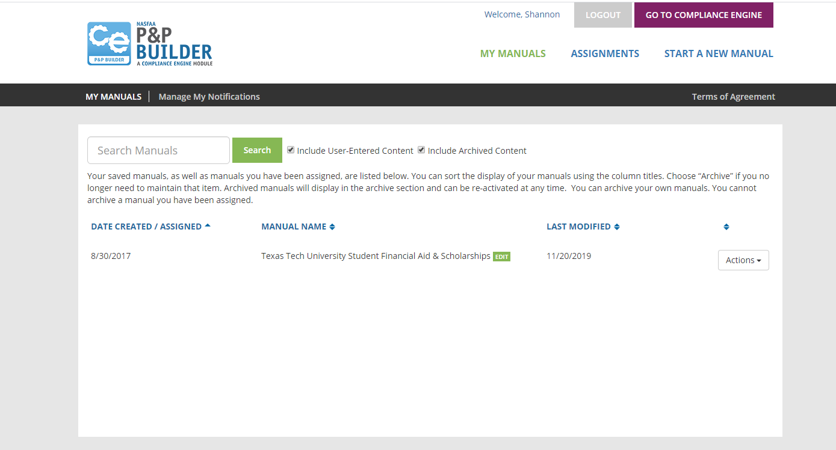
Notes:
On January 10th – NASFAA Today’s New – link to P&P Builder User Manual Available –
Listed this link in your resources handout
Step by step guide to adding content, assigning items, manual action, printing, archiving, rolling over
Slide illustrates – my “sandbox” practice site

Slide 6
The P&P Builder outlines all of the major components needed in your P&P as well as all required sections for federal compliance
Subsections Helps You…
    Be Thorough in Your Approach
    Provide Guidance Regarding Topics to include in your Policy Statements
    Know Applicable Statutory and Regulatory Citations for Each Section
“Reserved for Institution Use” Subsections
    Sections for Miscellaneous P&P Items
Notes:
Share Screen if possible of builder!

Slide 7
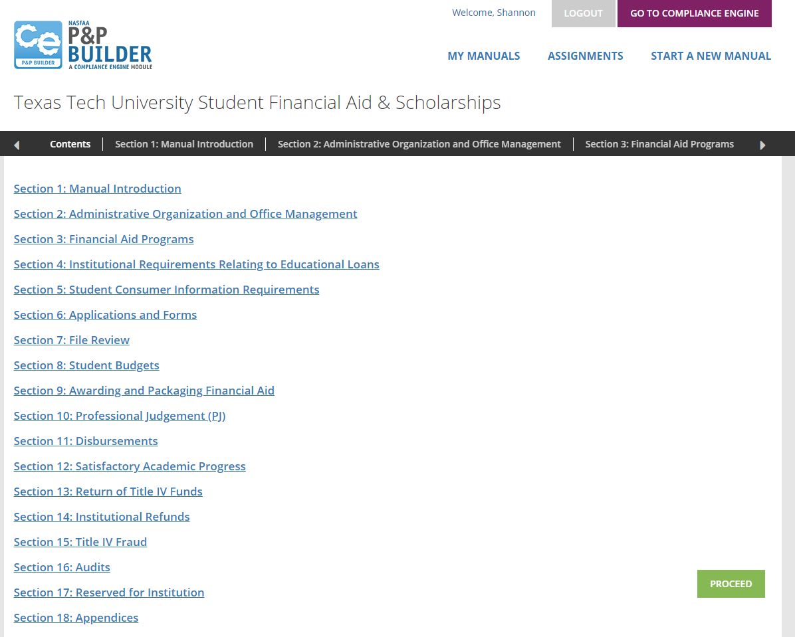
Notes:
Sections –
HIGHLIGHT - Reserved for institution use – NEXT SLIDE

Slide 8
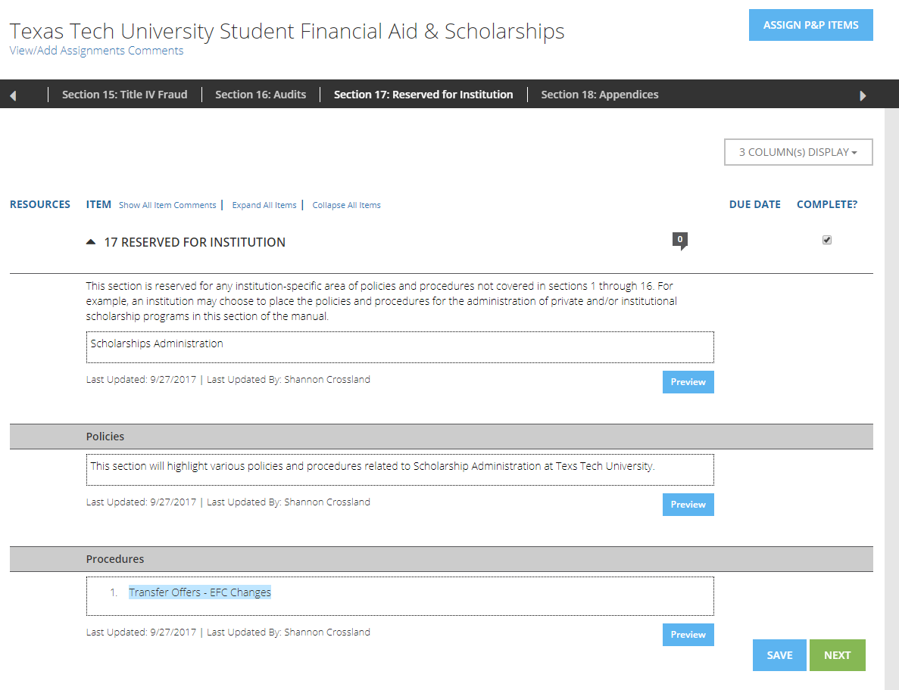
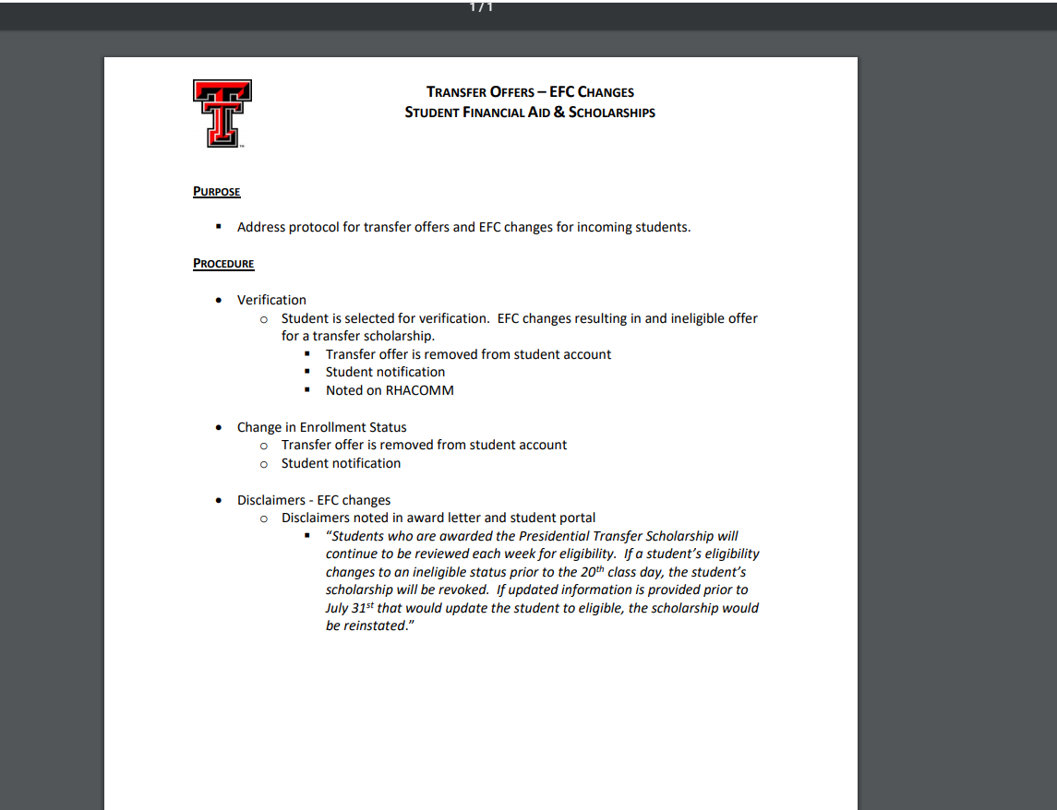
Notes:
Online – click on Transfer Offers hyperlink – takes you to procedure

Slide 9
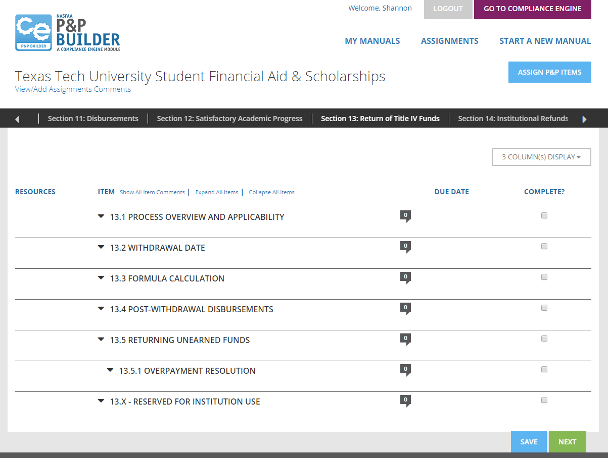
Notes:
FOLLOW P&P THROUGH FOR EACH TOOL
R2TIV

Slide 10
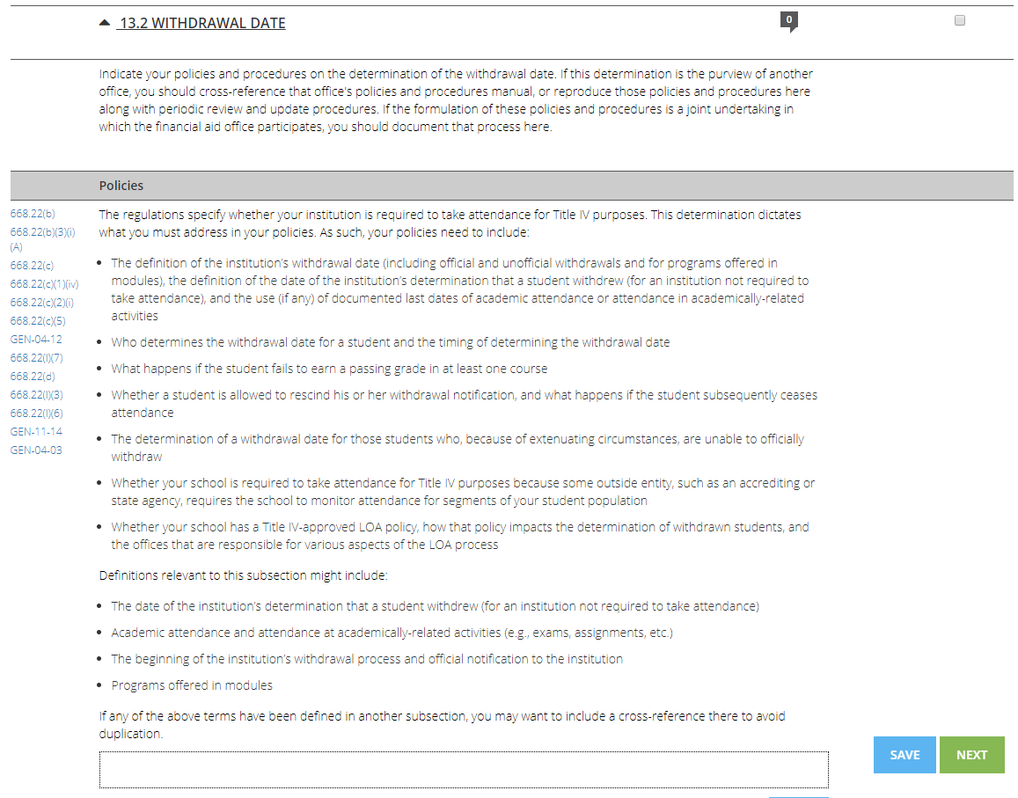
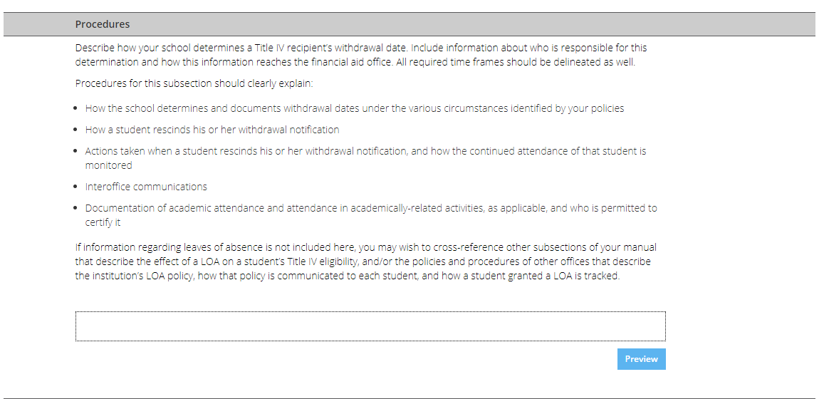
Notes:
FOLLOW P&P THROUGH FOR EACH TOOL
R2TIV
Use as a guide to review current P&Ps and make adjustments as need be.
Regulatory references easily accessible throughout the template and can be embedded in the manuals to simplify your research
Enter responses through the template to create one or more manuals for your institution
Copy, paste, and format existing and new content easily with familiar document management functions:
Text
Graphics
Links
Easy upload tools for images and related files

Slide 11
Regulatory references easily accessible throughout the template and can be embedded in the manuals to simplify your research
Enter responses through the template to create one or more manuals for your institution
Copy, paste, and format existing and new content easily with familiar document management functions:
        Text
        Graphics
        Links
Easy upload tools for images and related files

Slide 12
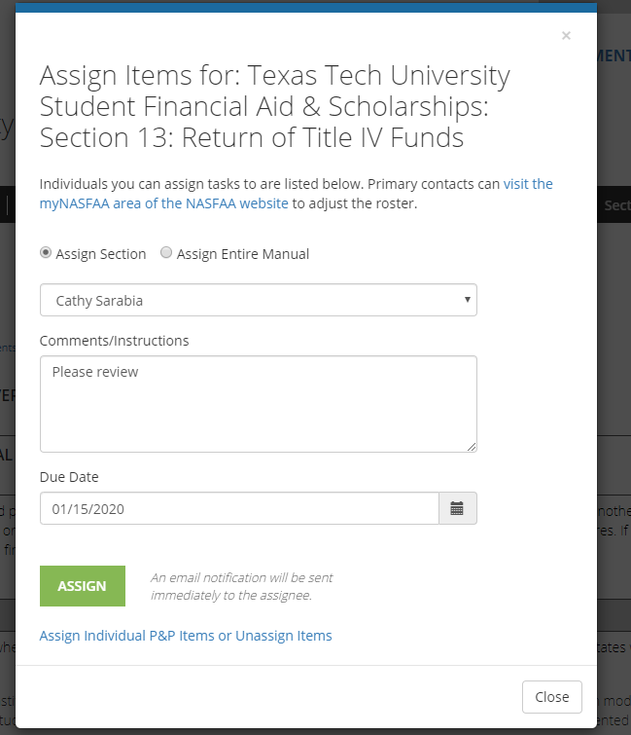
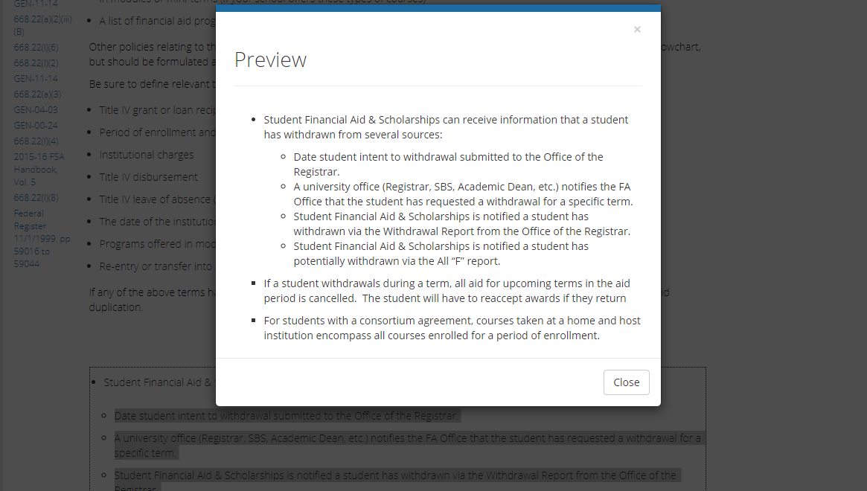
Notes:
FOLLOW P&P THROUGH FOR EACH TOOL
R2TIV
Copy and paste into template.
Assignments –

Slide 13
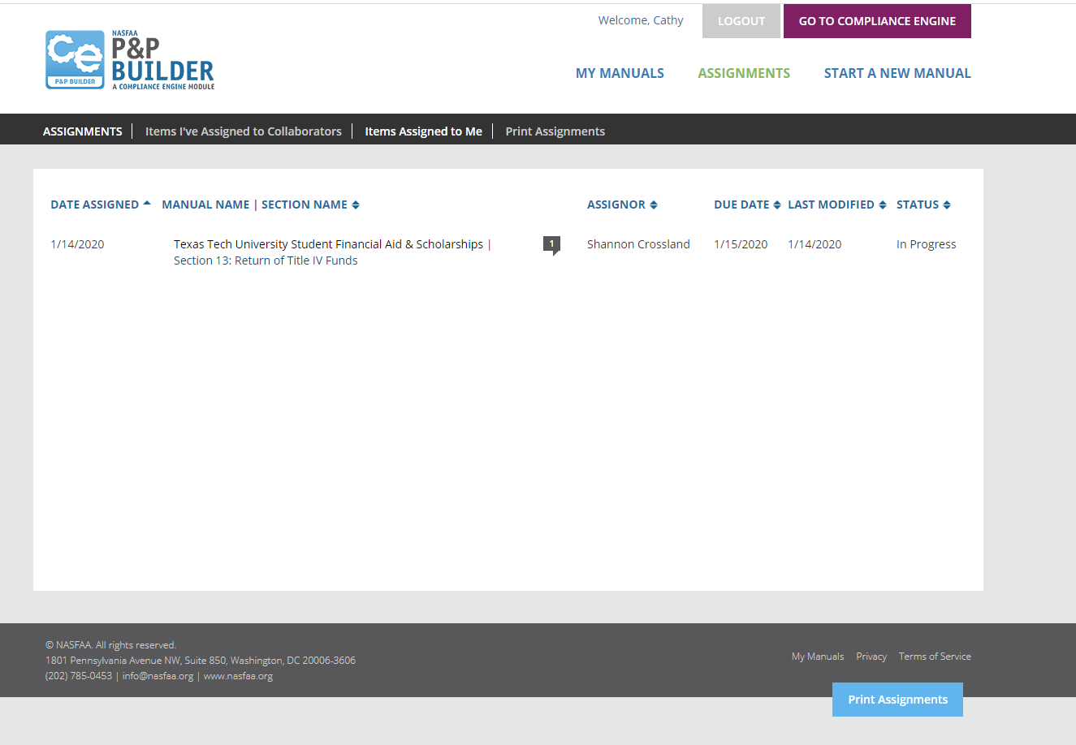
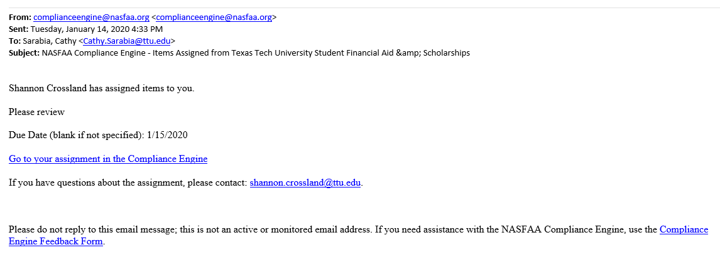
Notes:
FOLLOW P&P THROUGH FOR EACH TOOL
R2TIV

Slide 14
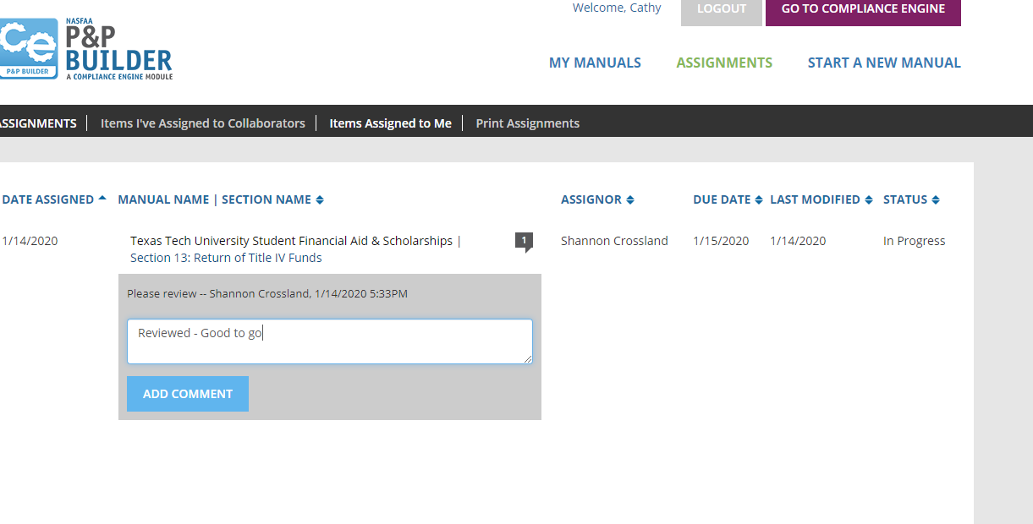
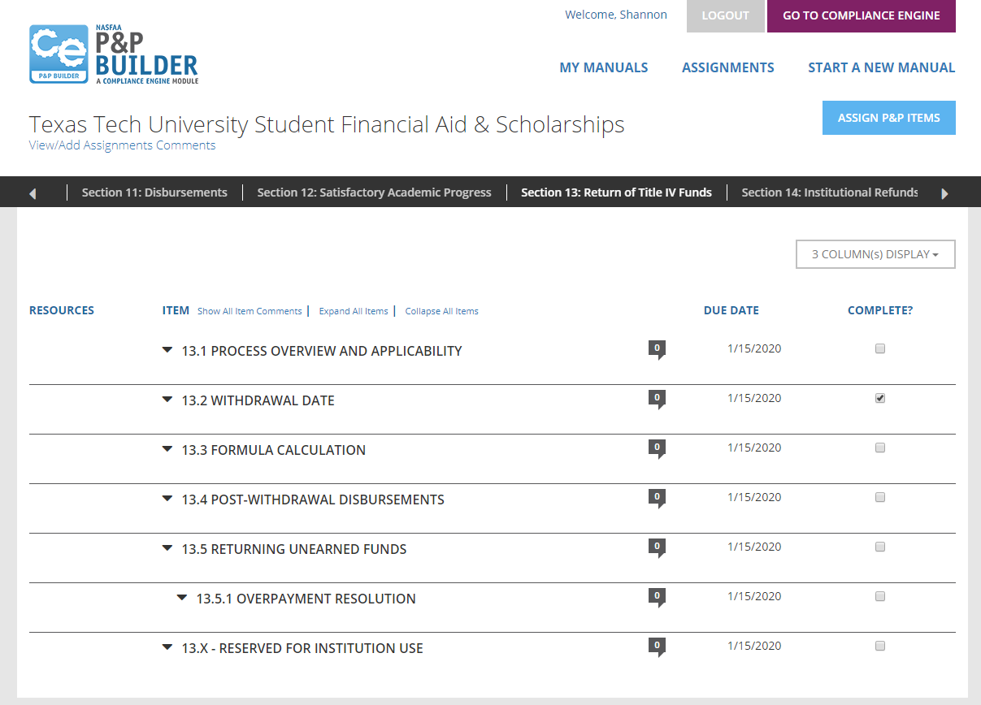
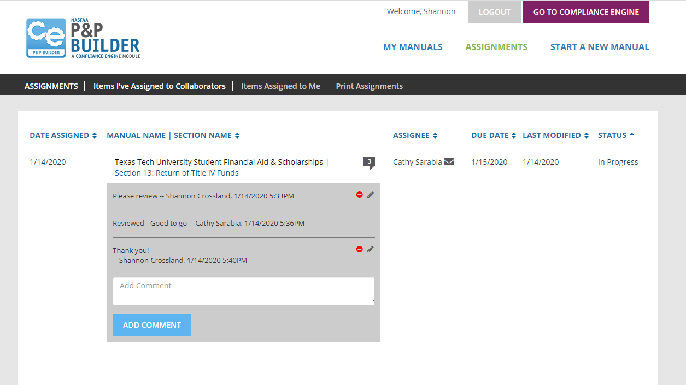
Notes:
FOLLOW P&P THROUGH FOR EACH TOOL
R2TIV
COMPLETE
Log

Slide 15
Automatically displays last time your P&P was updated and by whom. This is an important feature for tracking purposes.
The “View/Add Assignment Comments” tool is great to use as a reminder or as a follow-up
Users may assign portions of the manual to staff within your department and in other areas on campus.
  Assignments can be tracked easily with due dates, last modified, status and section items.
Notes:
Assignments can be tracked easily with due dates, last modified, status and section items.
Read or Write Access
- Can Print Assignment Summary
Sections to Include
Assignee
Status of Assignment
- Assign Sections to Staff to Write by Section & Subsection
Email Notification
Completion Timelines

Slide 16
The P&P Builder displays what needs to be in that section, thus meeting helping your school meet compliance requirements.
Going through an audit or program review?
  Easy downloads let you save your manual as a PDF for sharing with stakeholders.
  Links to federal regulations make it easy to compare your policy with the requirements.
Notes:
OVERVIEW and SUMMARY
NASFAA continues to release new functionality and improvements – look for release updates in Today’s News!

Slide 17
Helpful Hints
Functionality
The P&P Builder displays what needs to be in that section, thus meeting helping your school meet compliance requirements.
Going through an audit or program review?
  Easy downloads let you save your manual as a PDF for sharing with stakeholders.
  Links to federal regulations make it easy to compare your policy with the requirements.
Notes:
Automatically displays last time your P&P was updated and by whom. This is an important feature for tracking purposes.
The “View/Add Assignment Comments” tool is great to use as a reminder or as a follow-up
Users may assign portions of the manual to staff within your department and in other areas on campus.
Assignments can be tracked easily with due dates, last modified, status and section items.
Read or Write Access
- Can Print Assignment Summary
Sections to Include
Assignee
Status of Assignment
- Assign Sections to Staff to Write by Section & Subsection
Email Notification
Completion Timelines

Slide 18
SWASFAA NEEDS YOU!
Volunteer - https://www.swasfaa.org/Volunteer
Committee Members
  Chair: Shannon Crossland, Texas Tech University
  Arkansas Representative: TBD
  Louisiana Representative: TBD
  New Mexico Representative: TBD
  Oklahoma Representative: Audra Main, Moore Norman Technology Center
  Texas Representative: James Smith, Lone Star College
Notes:
Currently our committee needs representatives from Arkansas, Louisiana and New Mexico. Please let us know if you are interested.

